Slide 1
Impact of COVID-19 on CDI departments
Survey issued to ACDIS members and broader list of CDI professionals; respondents include Baptist Health, HCA, Advent Health, Ohio Health, Mayo Clinic, Adventist, SCL Health, and many more organizations, large and small
Nearly 800 respondents; survey closed Monday, May 11

Slide 2
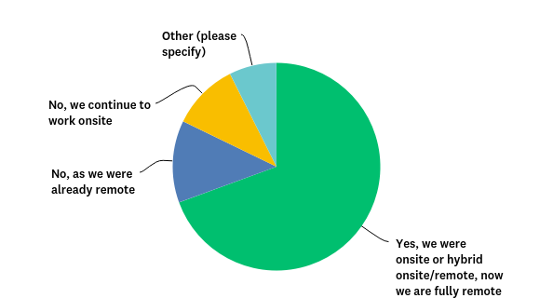
Q1: Has your CDI program moved to 100% remote as result of the COVID-19 pandemic?
Answered: 798 Skipped: 0

Slide 3
Q1: Has your CDI program moved to 100% remote as result of the COVID-19 pandemic?

Slide 4
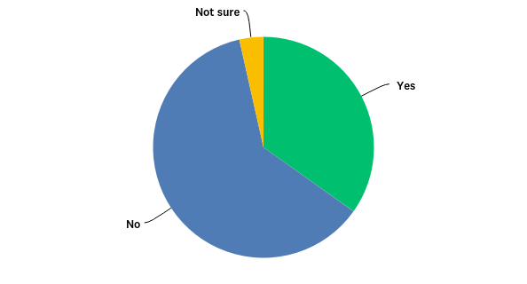
Q2: Has your CDI staff been asked to perform tasks outside of core record review activities?
Answered: 798 Skipped: 0

Slide 5
Q2: Has your CDI staff been asked to perform tasks outside of core record review activities?
Answered: 798 Skipped: 0

Slide 6
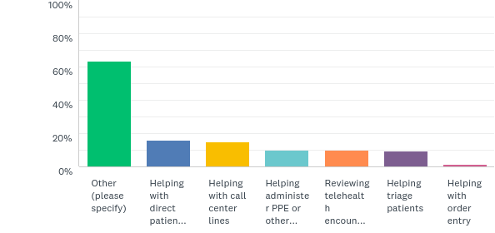
Q3: If you are performing tasks outside of record reviews, what do they include? If you have not taken on additional responsibilities, please skip this question. (Please check all that apply.)
Answered: 366 Skipped: 432

Slide 7
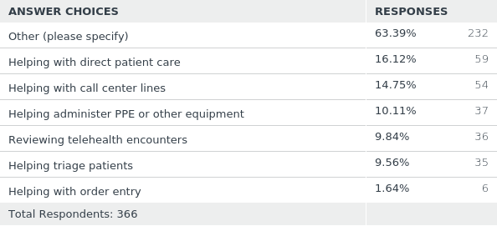
Q3: If you are performing task outside of record reviews, what do they include? If you have not taken on additional responsibilities, please skip this question. (Please check all that apply.)
Answered: 366 Skipped: 432

Slide 8
Q3: If you are performing task outside of record reviews, what do they include? If you have not taken on additional responsibilities, please skip this question. (Please check all that apply.)
Some interesting “other” responses:
Helping with other duties in our RevCycle environment and on call for backup bedside nursing as needed
Monitoring equipment supplies room
Concurrent coding because our coding vendor lost global coders due to shut down in India
Assisting with denials
All payer review
Followup calls to patients who have been discharged
Develop telehealth template for EHR, provide Telehealth education, assist various work groups regarding Telehealth
Drive-thru COVID testing center and working w/ ID for plasma consents
Screenings at entrance doors of hospital (taking temperatures and asking screening questions)
Answered: 366 Skipped: 432

Slide 9
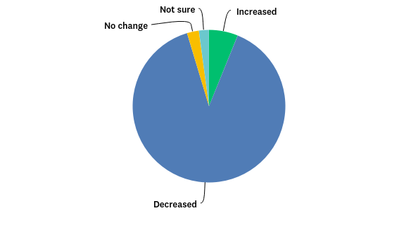
Q4: How has your patient census been impacted due to COVID-19?
Answered: 798 Skipped: 0

Slide 10
Q4: How has your patient census been impacted due to COVID-19?
Answered: 798 Skipped: 0

Slide 11
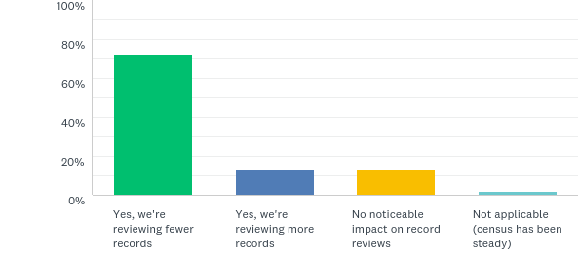
Q5: Have your record reviews been impacted due to the change in census?
Answered: 798 Skipped: 0

Slide 12
Q5: Have your record reviews been impacted due to the change in census?
Answered: 798 Skipped: 0

Slide 13
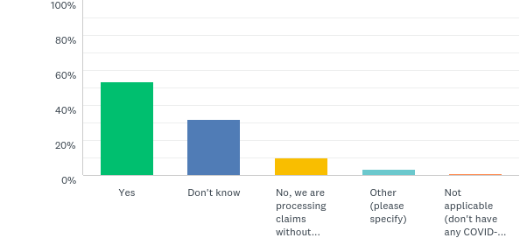
Q6: Is your facility holding possible/suspected COVID-19 claims until lab results are available?
Answered: 798 Skipped: 0

Slide 14
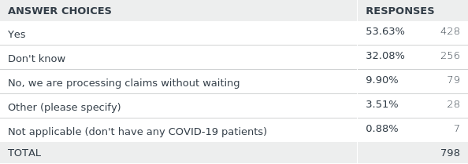
Q6: Is your facility holding possible/suspected COVID-19 claims until lab results are available?
Answered: 798 Skipped: 0

Slide 15
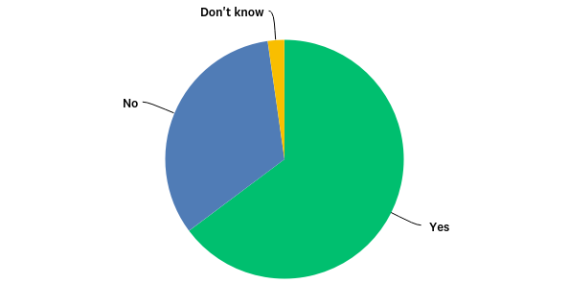
Q7: Has your CDI department offered additional training or professional development since the COVID-19 outbreak?
Answered: 798 Skipped: 0

Slide 16
Q7: Has your CDI department offered additional training or professional development since the COVID-19 outbreak?
Answered: 798 Skipped: 0

Slide 17
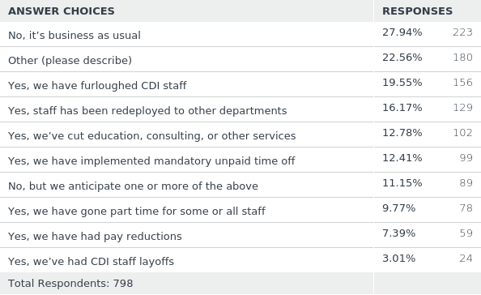
Q8: Has your CDI department been impacted by organizational cost-saving measures? (Please select all that apply.)
Answered: 798 Skipped: 0

Slide 18
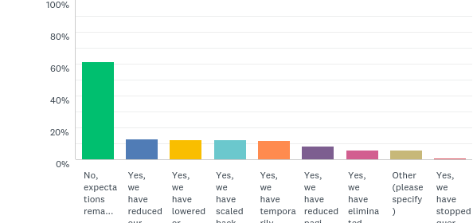
Q9: Has your CDI department reduced documentation expectations of physicians? (Please select all that apply.)
Answered: 798 Skipped: 0

Slide 19
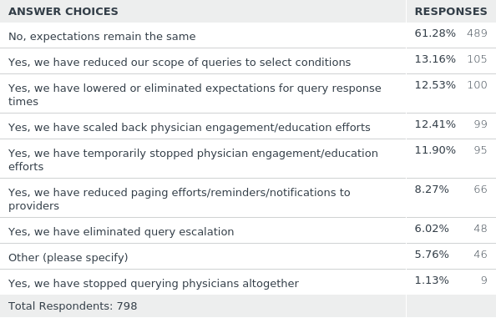
Q9: Has your CDI department reduced documentation expectations of physicians? (Please select all that apply.)
Answered: 798 Skipped: 0

