Slide 1
Webinar will begin shortly!
Please note: Starting 15 minutes before the program begins, you should hear hold music after logging in to the webinar room. The room will be silent at other times.

Slide 2
ACDIS Insights: The second surge impact of COVID-19 on CDI
AN ACDIS WEBINAR PRESENTED ON FEBRUARY 11, 2021

Slide 3
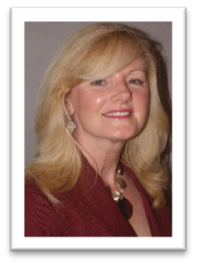
Presented By
Tonia Catapano, BSN, RN, MHL, CCDS, CCS, RHIA, is the Director of Clinical Finance Operations for Yale New Haven Health System in New Haven, CT. She provides oversight to CDI, Inpatient and Outpatient Coding including Home Care, Clinical and DRG Denials, Utilization Review and Utilization Management & Revenue Recovery. Catapano joined the CDI profession ten years ago and has worked to align the clinical and quality arena with the finance operations across the system.

Slide 4
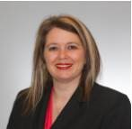
Presented By
Angie Comfort, RHIA, CDIP, CCS, CCS-P, CICA, is the senior director of CDI and coding operations for LifePoint Health in Brentwood, Tennessee. She has 30 years of experience in HIM, coding, and CDI. Prior to joining LifePoint, she was the senior director of HIM practice excellence for AHIMA. Comfort is a member of the Tennessee Health Information Management Association and is the MTHIMA president-elect. She has spoken as a subject matter expert for local, national, and international engagements. Comfort received a Bachelor of Science in Health Administration from Stephens College and an MBA from Trevecca Nazarene University.

Slide 5
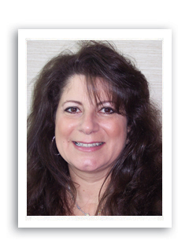
Presented By
Adelaide M. La Rosa, RN, BSN, CCDS, CCDS-O, is the CHS Vice President for HIM, CDI, DRG Appeals, and EMPI for Catholic Health. She has 36 years of varied clinical healthcare and leadership experience and extensive knowledge of healthcare revenue cycle, ICD-10-CM/PCS, CPT-4 coding rules and regulations, MS/APR-DRG methodology, DRG validation, RAC and third-party insurance denials management. La Rosa is a recipient of the 2010 ACDIS Recognition of CDI Professional Achievement award.

Slide 6
Learning Objectives
At the completion of this educational activity, the learner will be able to:
  Review national survey data and analyze the impact of COVID-19 on CDI departments
  Incorporate lessons learned from three organizations impacted by the second COVID-19 surge
  Discuss the transition to remote CDI work, including challenges, successes, and long-term impacts
  Review coding, billing, and reconciliation issues related to COVID-19 documentation, including early efforts in the CMS Acute Hospital Care at Home program and strategies to capture positive test results and qualify for DRG bonus payments

Slide 7
Organizational profiles

Slide 8
Yale New Haven Health

Slide 9
Yale New Haven Health Overview
About the organization
  Yale New Haven Health consists of 5 hospitals across 7 campuses, Northeast Medical Group with 130 physician practice sites, virtual hospice program, 2 home care agencies and 1 SNF
  2,600 licensed beds
  125,000 discharges annually
  3.5M outpatient encounters annually
  Employs 26,000 staff and 8,400 medical staff

Slide 10
Yale New Haven Health CDI Structure
  Dual reporting to System Finance and System Chief Clinical Officer
  Manager, 2 Supervisors and 3 leads
    40 staff FTEs and 15 contract CDI
      RN/APRN, MD/FMG/PAs

Slide 11
Yale New Haven Health CDI Program Highlights
Clinical Documentation Department Program
  Epic and 3M 360
  100% CDI & Coding collaboration
    All payer review
    Quality measures: Risk adjustment/mortality/PSIs/HACs
    Clinical validation and reimbursement
    Concurrent reviews
    Post coding & CDI prebill second level reviews
    CDI/Coding 100% reconciliation

Slide 12
LifePoint Health

Slide 13
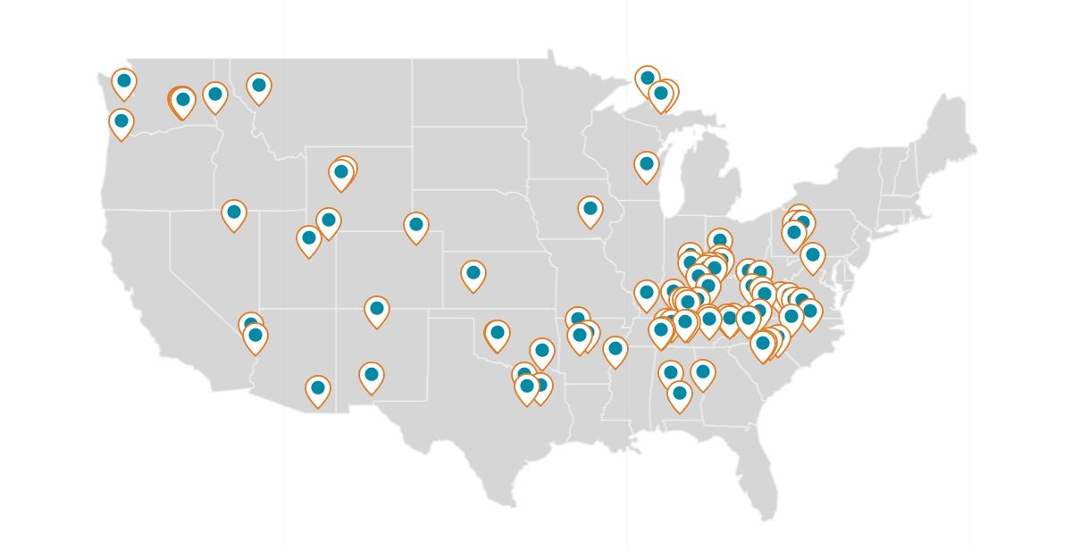
LifePoint Health
Serving 80+ communities in 30 states
Over 12,000 acute patient beds

Slide 14

LifePoint Health – CDI Structure
CDI programs at 79 acute care facilities
140 practicing CDIS reporting through HIM
Credentialed staffing
  RN, LPN with CCDS and/or CDIP
  RHIA, RHIT, CCS with CCDS and/or CDIP
Inpatient CDI focus
  All facilities review DRG payors
  Some facilities review all payor types
14 EHR systems
  Meditech, Siemens, MedHost, Cerner, EPIC, Allscripts, Paragon, McKesson Series
Hybrid work environment
This Photo by Unknown Author is licensed under CC BY-SA

Slide 15
LifePoint Health – Impact of COVID-19 2020
Overall LifePoint CDI Impact
Lower patient volumes = less CDIS needed for patient review
Paused the query escalation policy to allow physicians more time for patient care
Halted physician education to ensure physicians were available for clinical care of potential patients
Facility Impact
LifePoint Employee Impact
Temporary Leave of Absences
Reduction in non-essential employee hours
LifeCare Disaster Recovery Fund
COVID-19 Sick Pay
Child/Elder care stipends
Mandatory masking of all employees in patient care areas
Zero visitor protocols
Limited entry points (no more than two), common areas closed
100% screening of all entering
Cancellation of non-urgent elective procedures and testing
Telehealth options when appropriate
Volunteer programs suspended
9000+ patients tested for COVID-19
RN CDIS being used in clinical roles
CDIS screening at facility entrances
Employee Assistance Program
Leadership Coaching
LifeLeader Development
43% staff hours reduced
No staff layoffs
http://www.lifepointhealth.net/covid-19-response

Slide 16
LifePoint Health – Impact of COVID-19 2021
Overall LifePoint CDI Impact
Continued lower outpatient volumes
Reengage with physicians for ongoing education
Facility Impact
LifePoint Employee Impact
LifeCare Disaster Recovery Fund
COVID-19 Sick Pay
Child/Elder care stipends
Mandatory masking of all employees
Telehealth options when appropriate
CDIS screening at facility entrances
Employee Assistance Program
Leadership Coaching
LifeLeader Development
RN CDIS being used in clinical roles
Roll-out of COVID-19 vaccinations
RN CDIS loss due to use in clinical roles versus CDI
Continuation of pausing the query escalation policy to allow physicians more time for patient care
LOS issues due to COVID-19
Less inpatients due to bed availability
Cancelled all non-essential business travel
Non-clinical positions work remotely
Limited entry points (no more than two), common areas closed
100% screening of all entering
Telehealth options when appropriate
Volunteer programs suspended
Resumed some non-urgent elective procedures and testing with pre-op COVID-19 testing on all
Face shields by employees in patient care areas
CDI vacancies
http://www.lifepointhealth.net/covid-19-response

Slide 17
Catholic Health

Slide 18
Catholic Health Overview
Six Acute Hospitals
St Francis Hospital and Heart Center (364 Beds)
Mercy Hospital (405 Beds)
St. Catherine of Siena Hospital (350 Beds)
St Charles Hospital (260)
St Joseph Hospital (203)
Good Samaritan Hospital (477)
Three skilled Nursing Facilities
Home Nursing Services
Hospice

Slide 19
CDI Program
Six acute facilities with robust inpatient CDI programs
Over the last 3-4 years we have moved towards hybrid onsite/remote work schedule. Currently all CDI staff working remote until further direction
EPIC is our source of truth
CDI currently performs concurrent and restrospective reviews on all payers.
CDI staff consist of RNs, NPs and PAs who are knowledgeable in ICD-10 CM/PCS coding rules and regulations

Slide 20
COVID-19 Impact
Continue to ensure safety of our staff.
All coding analyst and CDI have remained remote from home since the first surge knowing there would be another surge.
Reinforce established policy on working remotely from home and monitor productivity and physician engagement.
Volume and landscape of reviews of the population of our patients we treat continues to vary
  Coding and CDI provided policies and procedures to accurately code and capture documentation for COVID-19 patients
  Newsletters emailed/mailed to the medical team regarding documentation guidelines
  New CPT codes to be added to chargemaster to reflect COVID-19 testing performed and vaccine administration
Acute Hospital at Home (HaH) Program
  All six acute hospitals applied for CMS waiver which allows for increasing capacity to care for patients during COVID-19

Slide 21
Survey results: Second surge impact of COVID-19 on CDI

Slide 22
201
Total Responses
Survey opened December 2020; closed Jan. 15, 2021

Slide 23
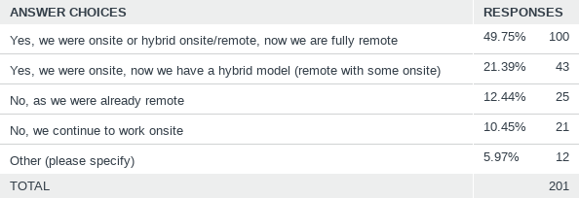
Q1: Has your CDI program moved to remote as a result of the COVID-19 pandemic?

Slide 24
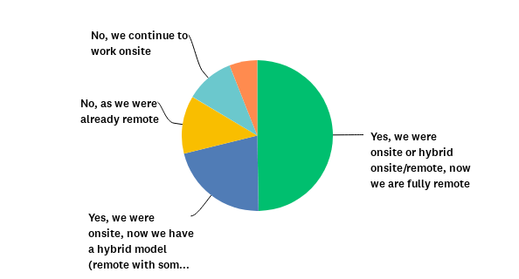
Q1: Has your CDI program moved to remote as a result of the COVID-19 pandemic?

Slide 25
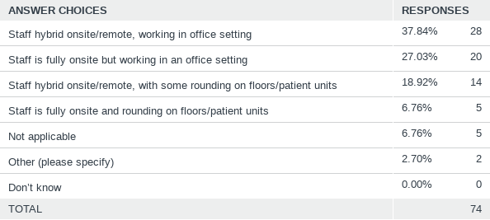
Q2: If you have staff working onsite, please describe your current onsite work arrangement.
Answered: 74 Skipped: 127

Slide 26
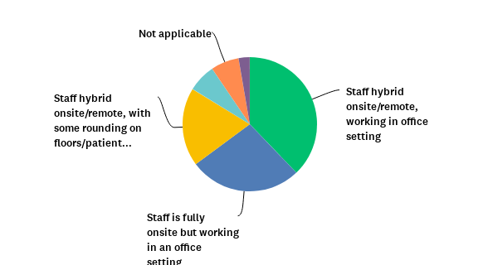
Q2: If you have staff working onsite, please describe your current onsite work arrangement.

Slide 27
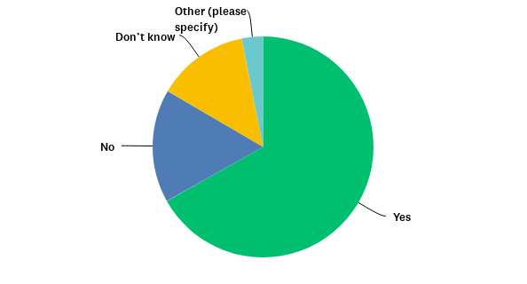
Q3: Does your organization review COVID-19 accounts pre-bill to help ensure the presence or absence of a positive test result, and/or otherwise ensure accurate coding/billing of COVID-19?

Slide 28
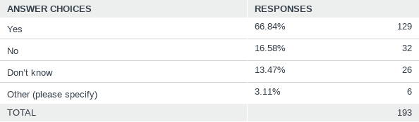
Q3: Does your organization review COVID-19 accounts pre-bill to help ensure the presence or absence of a positive test result, and/or otherwise ensure accurate coding/billing of COVID-19?

Slide 29
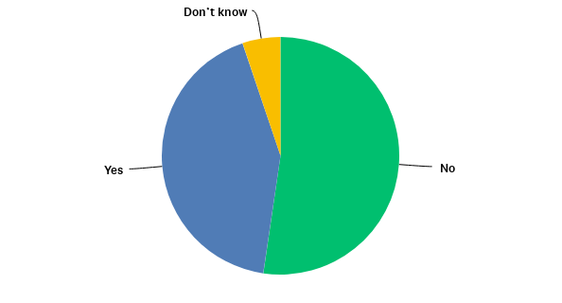
Q4: Has your CDI staff been asked to perform tasks outside of core record review activities in the last 2-3 months, since the recent national spike in cases?

Slide 30
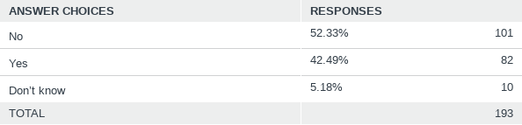
Q4: Has your CDI staff been asked to perform tasks outside of core record review activities in the last 2-3 months, since the recent national spike in cases?

Slide 31
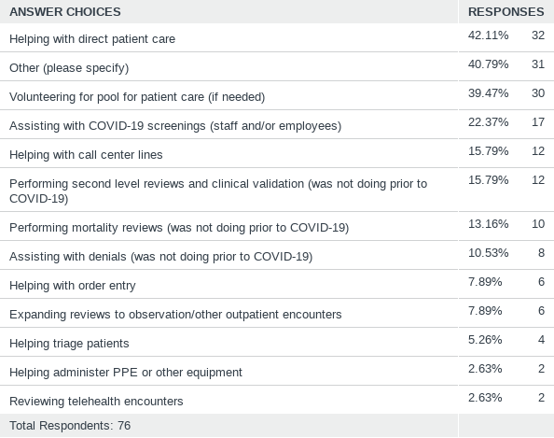
Q5: If you are performing tasks outside of core record reviews, what do they include?
Check all that apply. If you have not taken on additional responsibilities, please skip this question.

Slide 32
Q5. “Other” responses--sample
Administering COVID-19 vaccinations (many of these)
Case management duties/discharges/UR
Communication liaison between families and nursing, assisting with staff vaccinations, assisting with MDS's for our transitional/skilled bed unit
Staffing screening station
Assisting environmental services cleaning rooms

Slide 33
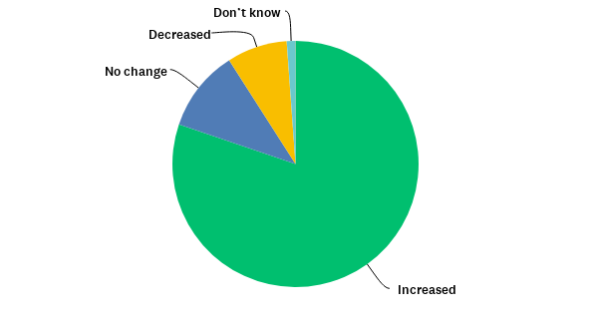
Q6: How has your patient census been impacted due to COVID-19 in the last 2-3 months, since the recent national spike in cases?

Slide 34
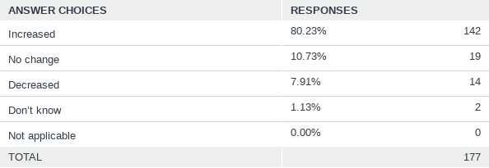
Q6: How has your patient census been impacted due to COVID-19 in the last 2-3 months, since the recent national spike in cases?

Slide 35
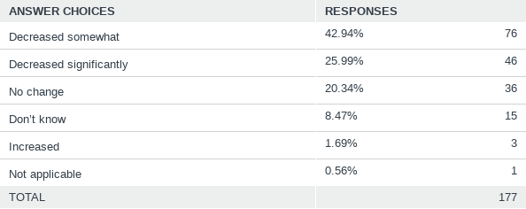
Q7: How have your hospital/organization’s surgical cases (elective surgeries) been impacted due to COVID-19 in the last 2-3 months, since the recent national spike in cases?

Slide 36
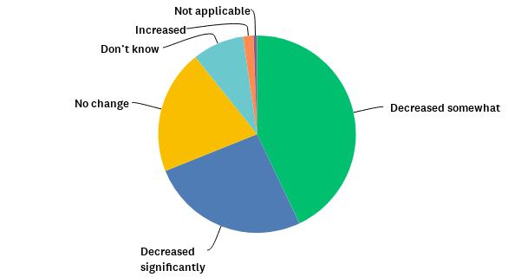
Q7: How have your hospital/organization’s surgical cases (elective surgeries) been impacted due to COVID-19 in the last 2-3 months, since the recent national spike in cases?

Slide 37
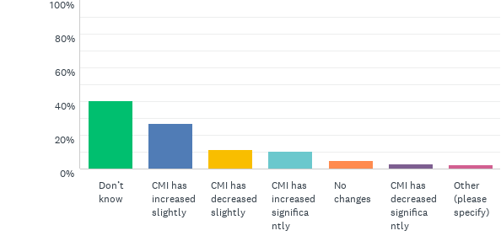
Q8: How have your hospital/organization’s finances been impacted by the COVID-19 pandemic?
Answered: 177 Skipped: 24

Slide 38
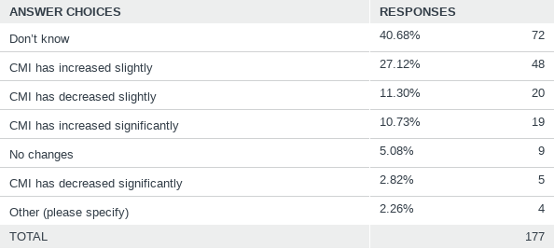
Q8: How have your hospital/organization’s finances been impacted by the COVID-19 pandemic?
Answered: 177 Skipped: 24

Slide 39
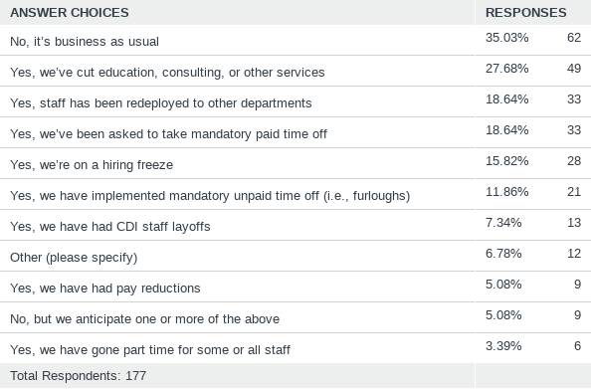
Q9: Has your CDI department been impacted by organization cost-saving measures? Select all that apply.

Slide 40
Q9: “Other” responses (sample)
No merit raises
Been asked to prepare to be deployed
Decreased retirement contributions
Benefits reduced/frozen vacation time
Business as usual, only because our Director has been awesome in finding us ways to help to continue to justify our hours

Slide 41
Q10: What other changes have you made or experienced due to COVID-19? Please describe (open-ended question)
We review all payers and are doing deeper dives on charts to include quality/PSI reviews
We had been able to increase coverage and reviewed 93% of patients; now gone back and prioritized by payer
Abstracting cases into a COVID ICU registry for several months
We have implemented pre-bill coding reviews of DRGs without CC/MCC, sole CC or MCC and mortality with low SOI/ROM
Moved to all payer review, but only on COVID patients. Since March 2020, we have placed COVID discharges on pre-bill holds
The biggest change for the CDS is the review for the positive COVID lab test. This info is sent to the coder and HIM operations staff for information and/or follow-up
Deeper dives, looking at OB, Newborn and Psych cases to determine if any opportunity for future reviews
Formal provider education has had to be put on hold
Education has gone virtual for CDI to practitioners and the CDI team gets coding updates often for better understanding of coding COVID. We dropped one contract CDI.
Our Hospitalists and Intensivists are swamped, we will be limiting our queries to financially impactful queries, PSI queries, and clinical validation queries during the COVID-19 volume increase

Slide 42
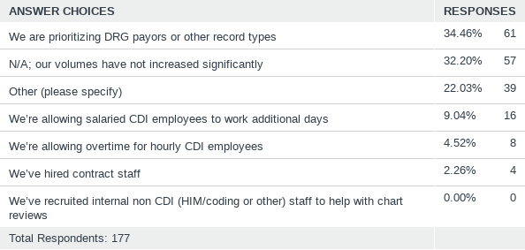
Q11: With the recent national spike in COVID-19 cases, how have you dealt with increased patient volume? Select all that apply.
Answered: 177 Skipped: 24

Slide 43
Q11: “Other” responses (sample)
Using new software that utilizes artificial intelligence to prioritize cases by documentation opportunities
Mortalities and COVID cases are prioritized
We're doing the best we can with what we have
Depending on current staff to work extra to get the reviews done with no additional pay

Slide 44
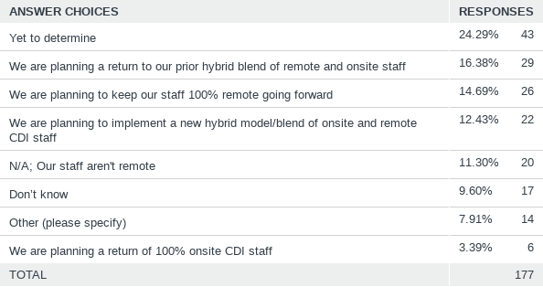
Q12: If your hospital or organization has gone remote, what are your future plans for remote work?

Slide 45
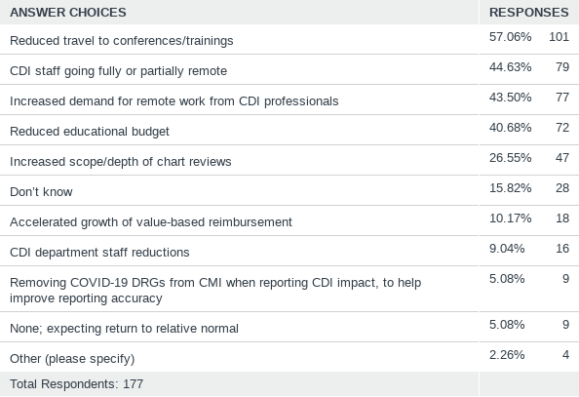
Q13: What short or long-term impacts do you expect from COVID-19? Check all that apply.

Slide 46
Panel discussion

Slide 47
Remote CDI: Present and future
  Transitioning to remote
  Staying connected while remote
  Loss of on-campus real estate
  Orientation of new staff
  Future of remote CDI?

Slide 48
Polling Question #1
How are you orienting new staff during the pandemic?
  We are coming on site (with PPE) to orient new staff
  We are orienting new staff remotely via Zoom/Goto/etc.
  We are using a vendor to assist with orientation
  We are not orienting new staff/no new hires at this time
  Other

Slide 49
Coding, billing, reconciliation aspects of COVID-19
  Capturing positive test results in the record, qualifying for DRG bonus payments
  Modifying EPIC/other EHRs for ease of capture
  CMS Acute Hospital Care at Home program
  Other documentation/coding/billing dilemmas

Slide 50
Acute Hospital at Home (HaH) Program
In November 2020, in response to the unprecedented public health crisis of Covid-19, CMS announced the Acute Hospital at Home (HaH) program. The stated goal was to provide “eligible hospitals with unprecedented regulatory flexibilities to treat eligible patients in their homes.” Patients could only be admitted after being evaluated in person in the hospital, and care would need to include a daily RN evaluation and twice daily in-person visits (nursing or paramedics). The CMS waiver focuses on increasing capacity to care for patients during COVID-19, and expires at the end of the public health emergency. CMS clearly differentiates this program from traditional home health services, and noted that Hospital at Home is for “beneficiaries who require acute inpatient admission to a hospital and who require at least daily rounding by a physician and a medical team monitoring their care needs on an ongoing basis.” In addition, the CMS waiver allows lifting of “§482.23(b) and (b)(1) of the Hospital Conditions of Participation, which require nursing services to be provided on premises 24 hours a day, 7 days a week and the immediate availability of a registered nurse for care of any patient.”

Slide 51

Coding and Documentation Impact on COVID Reimbursement
Inpatient Prospective Payment System (IPPS) Hospitals - Section 3710 of the CARES Act directs the Secretary to increase the weighting factor of the assigned Diagnosis-Related Group (DRG) by 20 percent for an individual diagnosed with COVID-19 discharged during the COVID-19 Public Health Emergency (PHE) period
https://www.cms.gov/files/document/se20015.pdf
COVID-19 Add on Payment for New Treatments
https://www.cms.gov/medicare/covid-19/covid-19-treatments-add-payment-nctap

Slide 52
Lessons learned
  What are your biggest takeaways from the pandemic, personally and professionally?
  What long and short-term impacts will it have on the future of the CDI profession?
  What do CDI departments need to do to bounce back?
  What is next for your respective organizations?

Slide 53
Questions & Answers
Tonia Catapano, BSN, RN, MHL, CCDS, CCS, RHIA
Director of Clinical Finance Operations
Yale New Haven Health System
Angie Comfort, RHIA, CDIP, CCS, CCS-P, CICA
Senior Director of CDI and Coding Operations
LifePoint Health
Adelaide LaRosa, BSN, RN, CCDS, CCDS-O
Vice President for HIM, CDI, DRG Appeals, EMPI
Catholic Health
To submit a question:
Click on the Q&A widget at the bottom of your screen.

Slide 54
This concludes today’s program.
Please do not close your browser.
Be sure to complete and submit the program evaluation. It is listed below, but a link will appear on your screen in a moment to complete it as well.
https://app.keysurvey.com/f/41489207/3eff/
Notes:
Quality, cost containment and customer satisfaction = Value

